Slide 1
Likelihood
NRES 776
Instructor: Heather Bryan
Nov 25, 2020

Slide 2
Announcements
1st draft of Project 2 due in lab next week for peer review session

Slide 3
Announcements
1st draft of Project 2 due in lab next week for peer review session
Project presentations Dec 7th in lecture (3-5 min each, questions at end)

Slide 4
Announcements
1st draft of Project 2 due in lab next week for peer review session
Project presentations Dec 7th in lecture (3-5 min each, questions at end)
Next lab will include review in prep for final lab exam

Slide 5
Announcements
1st draft of Project 2 due in lab next week for peer review session
Project presentations Dec 7th in lecture (3-5 min each, questions at end)
Next lab will include review in prep for final lab exam
Final lab exam (20% of grade, open book, independent) will be available in Blackboard Dec 9 and due Dec 16th at 5:00 pm
Some questions asking what analysis to use for a particular research question or to interpret output from an analysis
Some practical questions where you will apply techniques we learned in the labs using R

Slide 6
Announcements
1st draft of Project 2 due in lab next week for peer review session
Project presentations Dec 7th in lecture (3-5 min each, questions at end)
Next lab will include review in prep for final lab exam
Final lab exam (20% of grade, open book, independent) will be available in Blackboard Dec 9 and due Dec 16th at 5:00 pm
Some questions asking what analysis to use for a particular research question or to interpret output from an analysis
Some practical questions where you will apply techniques we learned in the labs using R
Guest lecture by Andrew Bateman next Wednesday

Slide 7
Learning Objectives
Explain what likelihood is and why it is useful
Calculate likelihood for a simple example
Describe meaning of maximum likelihood estimate and how to find it from a log-likelihood profile
Use likelihood to calculate confidence intervals and conduct hypothesis tests

Slide 8

Bootstrapping
Uses resampling from the data to approximate the sampling distribution of the estimate
Used to find a standard error of an estimate or confidence interval for a parameter estimate
Useful when no formula is available for the standard error or when the sampling distribution of the estimate of interest is unknown
Notes:
Image: https://www.survivingburningman.com/2017/08/06/shoes-bring-burning-man/

Slide 9
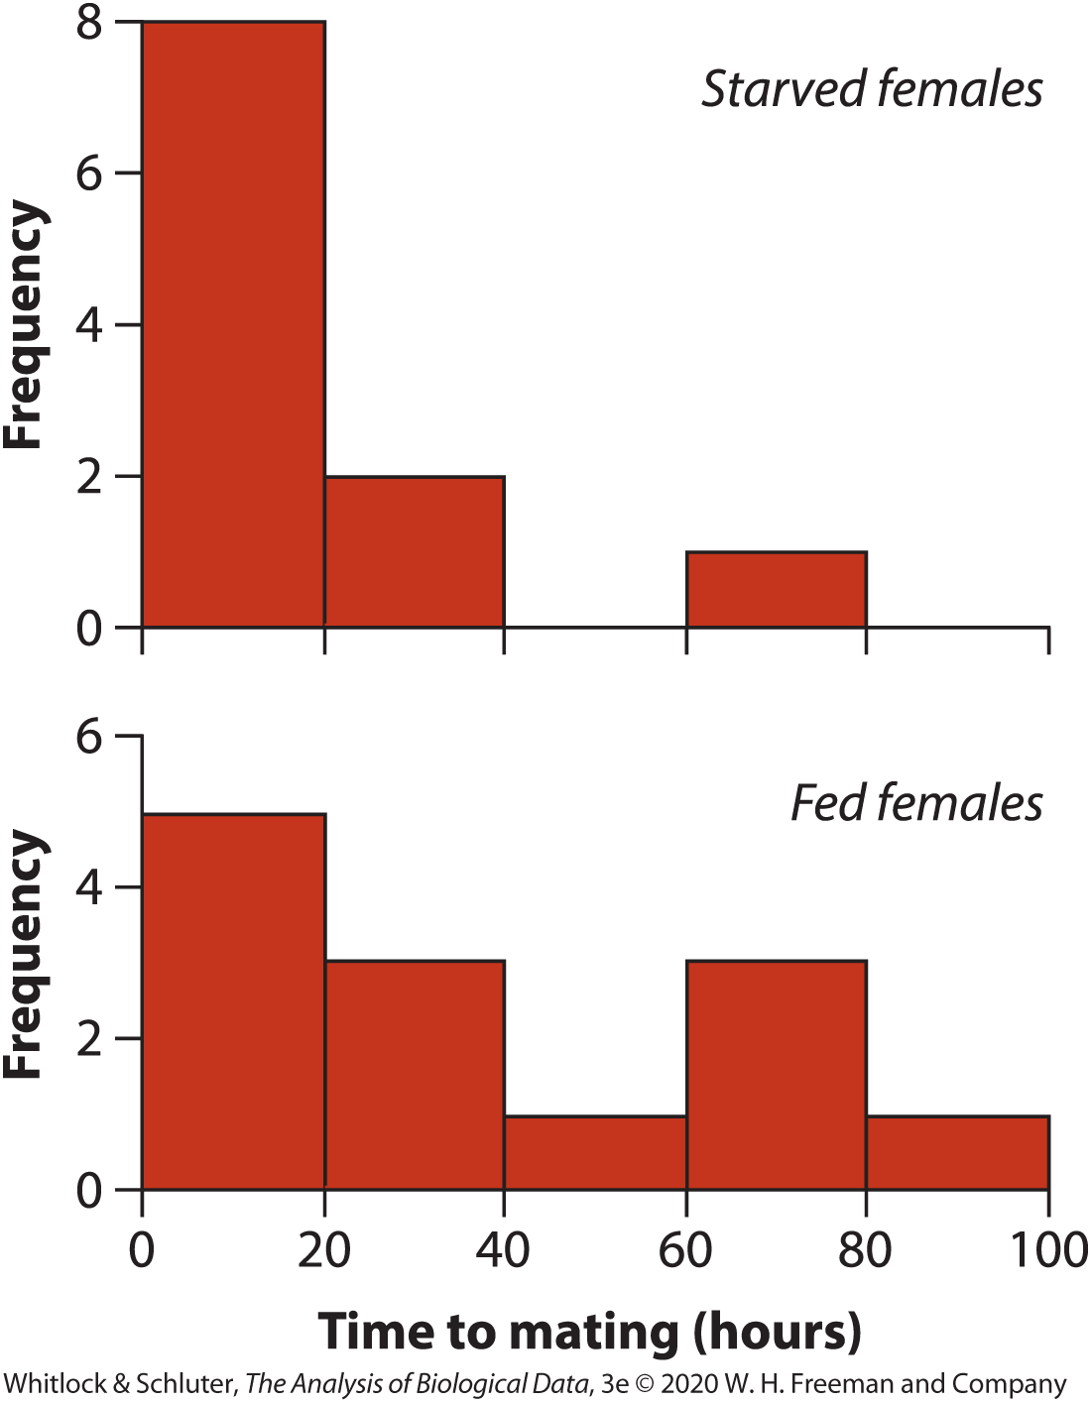
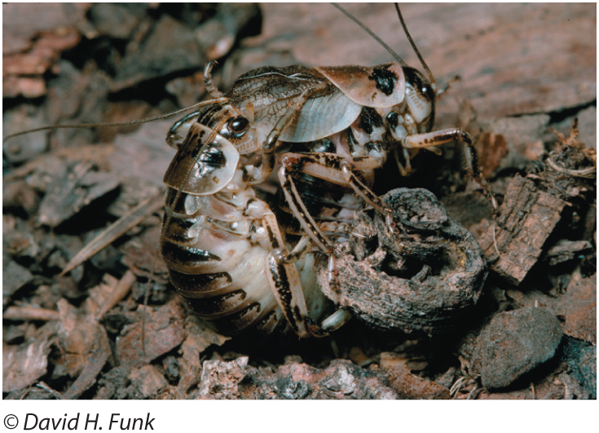
e.g., Sexual cannibalism in cave crickets
Bootstrapping with multiple groups
Notes:
-median time to mating was 13 hours for starved females and 22.8 hours for fed females

Slide 10
Difference in median time to mating: -9.8 hours 1) Resample from starved group (n=11) and fed group (n=13) 2) Calculate the median difference in the resampled data 3) Repeat 1000 times 4) Calculate confidence interval on the difference using bootstrap estimates of the difference
Bootstrapping with multiple groups
Notes:
-median time to mating was 13 hours for starved females and 22.8 hours for fed females

Slide 11
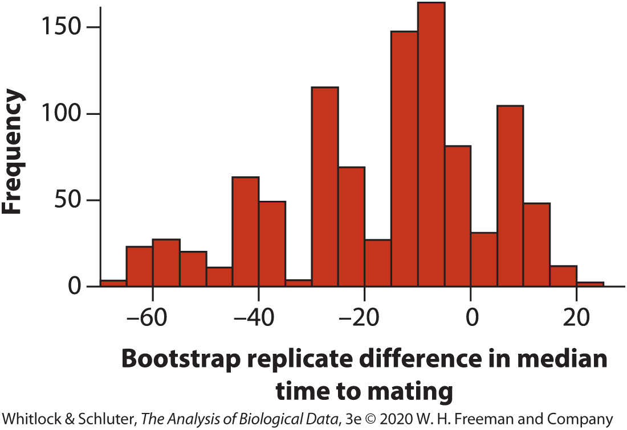
Bootstrapping with multiple groups
95% Confidence Interval (0.025 quantile to 0.975 quantile)
-62.5 < difference between medians < 12.2

Slide 12
Assumptions of bootstrapping
Each sample is a random sample from corresponding population
Sample must be large enough to reflect frequency distribution in the population
Bootstrap analyses on small samples will produce standard errors that are too small and confidence intervals that are too narrow, overestimating the precision of the estimate

Slide 13
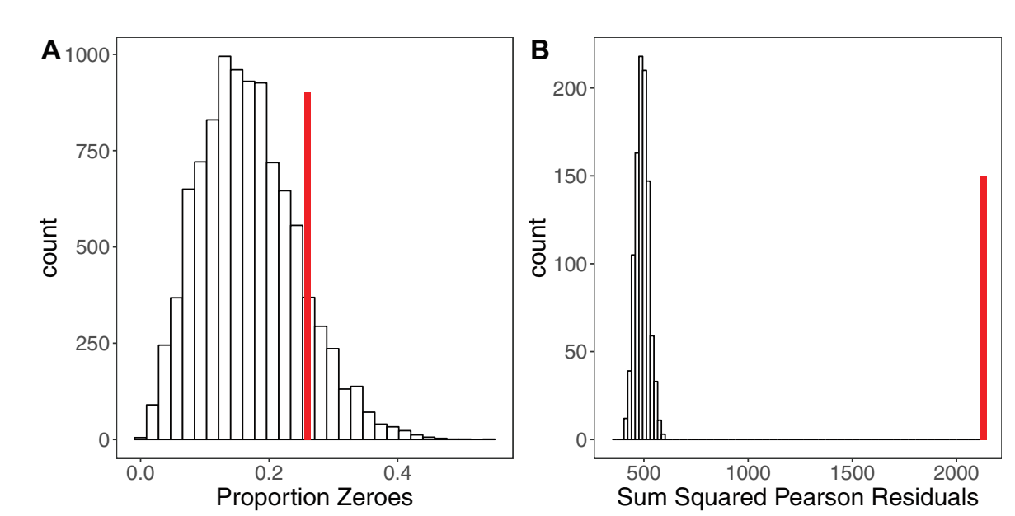
Simulation Further Applications
Assessing model fit for GLMMs (Harrison et al. 2017)
Notes:
-can use bootstrapping and simulation for more complex modeling
-example is in Harrison et al. 2017 (reading for tomorrow)
-excessive zeroes can be a problem with count data (may need to use zero-inflated models)
-they used simulation to generate 10,000 new data sets from a model they fit to see if there are more zeroes than expected due to chance
-in this case, their data set (observed number of zeroes, shown in Red) didn’t have more zeroes than would be expected by chance
-they used bootstrapping to determine whether there was evidence of overdispersion in their data
-re-sampled from simulated data 1000 times, each time calculated dispersion parameter and standard error
-compared expected sum of squares of pearson residuals under model with a dispersion parameter of 1 to the SS pearson residuals in the data

Slide 14
Summary for simulation and bootstrapping
Simulation can be used in hypothesis testing where the frequency distribution of test statistics calculated on the simulated samples gives a null distribution of the test statistic
Bootstrapping can be used to calculate standard errors of estimates and confidence intervals of parameters by resampling from the data

Slide 15
What is likelihood?
Likelihood measures how well the data support a particular value for a parameter.
Notes:
-best choice of parameter is the one with the highest likelihood, the one for which the data have the highest probability of occurring

Slide 16
What is likelihood?
Likelihood measures how well the data support a particular value for a parameter.
The likelihood of a specified parameter value is calculated as the probability of the data given this parameter value.
Notes:
-best choice of parameter is the one with the highest likelihood, the one for which the data have the highest probability of occurring

Slide 17
What is likelihood?
Likelihood measures how well the data support a particular value for a parameter.
The likelihood of a specified parameter value is calculated as the probability of the data given this parameter value.
Likelihood methods involve calculating the probability of obtaining the observed data for each possible value of the parameter and comparing the probability between different possible values
Notes:
-best choice of parameter is the one with the highest likelihood, the one for which the data have the highest probability of occurring

Slide 18
What is likelihood?
Likelihoods of parameters closer to true value should be higher than those farther from the true value

Slide 19
What is likelihood?
Likelihoods of parameters closer to true value should be higher than those farther from the true value
Maximum likelihood estimate is the value of the parameter for which the likelihood is highest

Slide 20
What is likelihood?
Likelihoods of parameters closer to true value should be higher than those farther from the true value
Maximum likelihood estimate is the value of the parameter for which the likelihood is highest
Examples of maximum likelihood estimates: mean, proportion

Slide 21
Uses of likelihood
Inferring evolutionary history from genomic data
Phylogeny
Maximum likelihood estimates sometimes used as best guess of parameter value
Fit many different types of complex models
Provide confidence intervals
Test hypotheses (including data that aren’t normally distributed)
Bayesian statistics

Slide 22
Review of probability
The probability of an event is the proportion of times that the event would occur if we repeated a random trial over and over again under the same conditions.

Slide 23
Review of probability
The probability of an event is the proportion of times that the event would occur if we repeated a random trial over and over again under the same conditions.
A probability distribution is a list of all mutually exclusive outcomes of a random trial and their probabilities of occurrence.

Slide 24
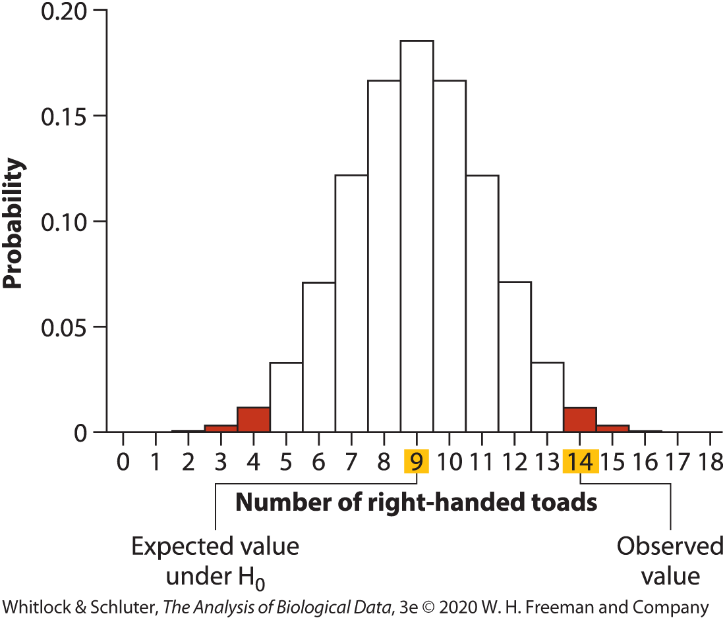


Review of probability
Right handedness in toads (expected H0 p = 0.5)
Binominal probability distribution
$$\operatorname{Pr}{[Y toads being right handed]}=\left(\frac{n}{y}\right)p^{Y}{(1−p)}^{n−Y}$$

Slide 25
Calculating Likelihood
Likelihood is a conditional probability
That is, the likelihood of a parameter value given the data, L(Param val. | D), is the probability of the data given this parameter value.
L(Param val. | D) = Pr(D | Param val.)

Slide 26
Likelihood vs. Probability
Likelihoods are calculated just like probabilities, but the difference is our orientation

Slide 27
Likelihood vs. Probability
Likelihoods are calculated just like probabilities, but the difference is our orientation
In calculating likelihoods, we are considering many parameter values and one outcome (i.e., the observed data)

Slide 28
Likelihood vs. Probability
Likelihoods are calculated just like probabilities, but the difference is our orientation
In calculating likelihoods, we are considering many parameter values and one outcome (i.e., the observed data)
In calculating probabilities, we are considering one parameter value and all possible outcomes (i.e., all of sample space)

Slide 29
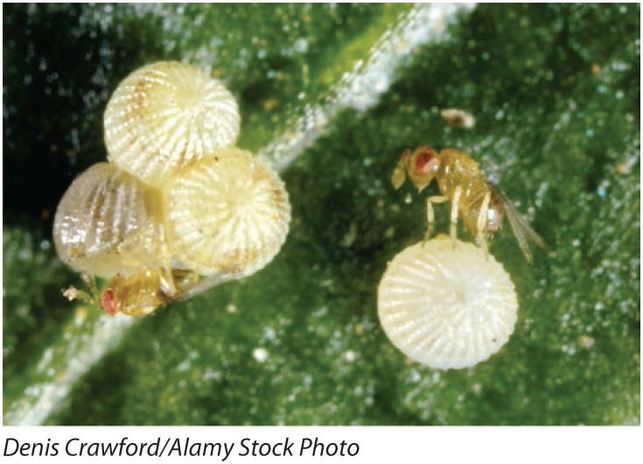
Likelihood Example
Notes:
Tiny wasp parasitizes eggs of cabbage white butterfly by riding on the butterfly until she lands to lay her eggs. Once she lays the eggs, the wasp parasitizes them. Researchers wanted to know whether the wasps could differentiate between butterflies that had been mated and those that hadn’t yet mated. They carried out trials where wasps were presented with mated and unmated female butterflies. Of 32 wasps test, 23 chose mated females and 9 chose unmated females.

Slide 30


Likelihood
Probability model
$$\operatorname{Pr}\left[Y choose mated | p\right]=\left(\frac{n}{y}\right)p^{Y}{(1−p)}^{n−Y}$$
Likelihood formula
$$L{[p|Y choose mated]}=\operatorname{Pr}\left[Y choose mated | p\right]=\left(\frac{n}{y}\right)p^{Y}{(1−p)}^{n−Y}$$
Notes:
Probability model here is conditional on p; we want to estimate the likelihood for different values of p
Likelihood formula: probability of obtaining the data for a given value of p

Slide 31
Likelihood
Likelihood formula where p = 0.5 and number of wasps that chose mated butterflies = 23 or 32 trials

Slide 32

Likelihood
Likelihood formula where p = 0.5 and number of wasps that chose mated butterflies = 23 or 32 trials
$$L{[0.5|23]}=\left(\frac{32}{23}\right){0.5}^{23}{(1−0.5)}^{32−23}$$
= 0.00653

Slide 33
Likelihood
Likelihood formula where p = 0.5 and number of wasps that chose mated butterflies = 23 or 32 trials
$$L{[0.5|23]}=\left(\frac{32}{23}\right){0.5}^{23}{(1−0.5)}^{32−23}$$
= 0.00653
Note: Likelihoods often expressed as natural logs, which can facilitate some calculations
E.g., ln(0.00653) = -5.03125

Slide 34
Table 20.3-1, The log-likelihood calculated for values of p between 0.52 and 0.88. The log-likelihood is maximized at p hat = 0.72. The third column calculates the difference between each log-likelihood and the maximum log-likelihood., Page 670a
Proportion, p | Log-likelihood | Log-likelihood – maximum
0.52 | −4.497 | −2.634
0.53 | −4.248 | −2.385
0.54 | −4.012 | −2.149
0.55 | −3.787 | −1.924
0.56 | −3.575 | −1.712
0.57 | −3.375 | −1.512
0.58 | −3.187 | −1.324
0.59 | −3.010 | −0.147
0.60 | −2.846 | −0.983
0.61 | −2.694 | −0.831
0.62 | −2.554 | −0.691
0.63 | −2.426 | −0.563
0.64 | −2.310 | −0.447
0.65 | −2.207 | −0.344
0.66 | −2.117 | −0.254
0.67 | −2.039 | −0.176
0.68 | −1.976 | −0.113
0.69 | −1.926 | −0.063

Slide 35
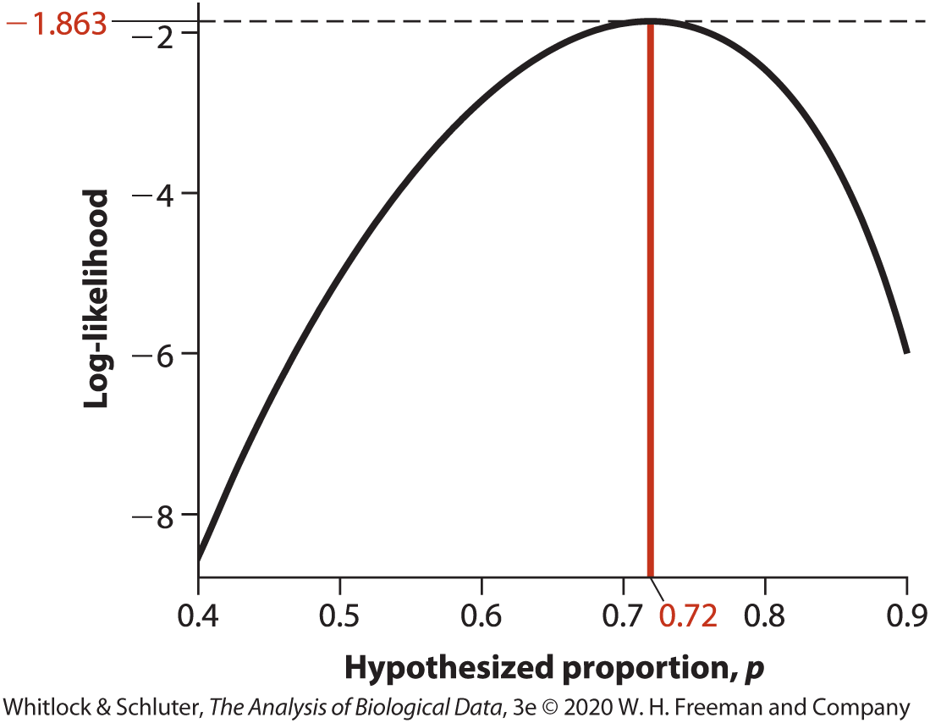

Maximum Likelihood Estimate
Log-likelihood curve
Maximum likelihood estimate of a parameter is the specific value having the highest likelihood given the data
Here: maximum of the log-likelihood curve occurs at $\hat{p}=0.72$
Same as p = 23/32 = 0.72

Slide 36
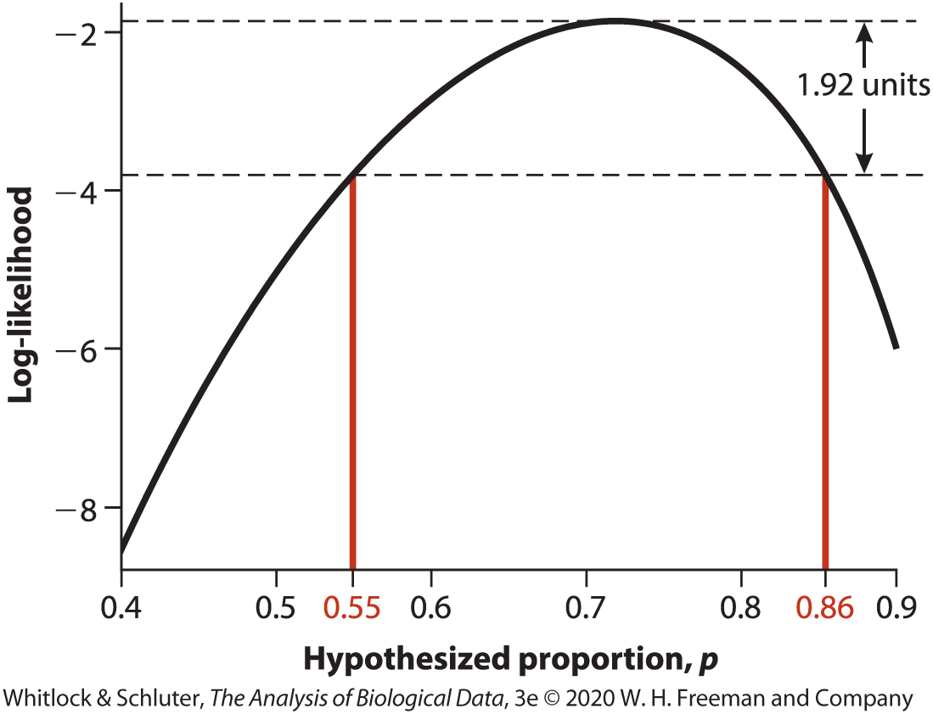
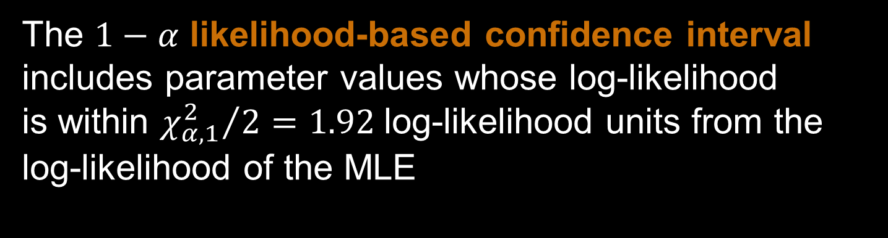
Likelihood-based Confidence Intervals
The $1−α$ likelihood-based confidence interval includes parameter values whose log-likelihood
is within ${χ_{α,1}^{2}}/{2=1.92}$log-likelihood units from the log-likelihood of the MLE
0.55<p<0.86

Slide 37
Log-likelihood ratio test
The Law of Likelihood states that the extent to which data supports one parameter value or against another is the ratio of their likelihoods.

Slide 38

Log-likelihood ratio test
The Law of Likelihood states that the extent to which data supports one parameter value or against another is the ratio of their likelihoods.
The Likelihood Ratio Test tests H₀ by comparing
$L\left[MLE\right|Data]$ to $L\left[H_{0}\right|Data]$, by finding G
$G=2 ln\left(\frac{L\left[MLE\right|Data]}{L\left[H_{0}\right|Data]}\right)=$ $2 (ln(L\left[MLE\right|Data])$-$ln\left(L\left[H_{0}\right|Data\right]))$

Slide 39
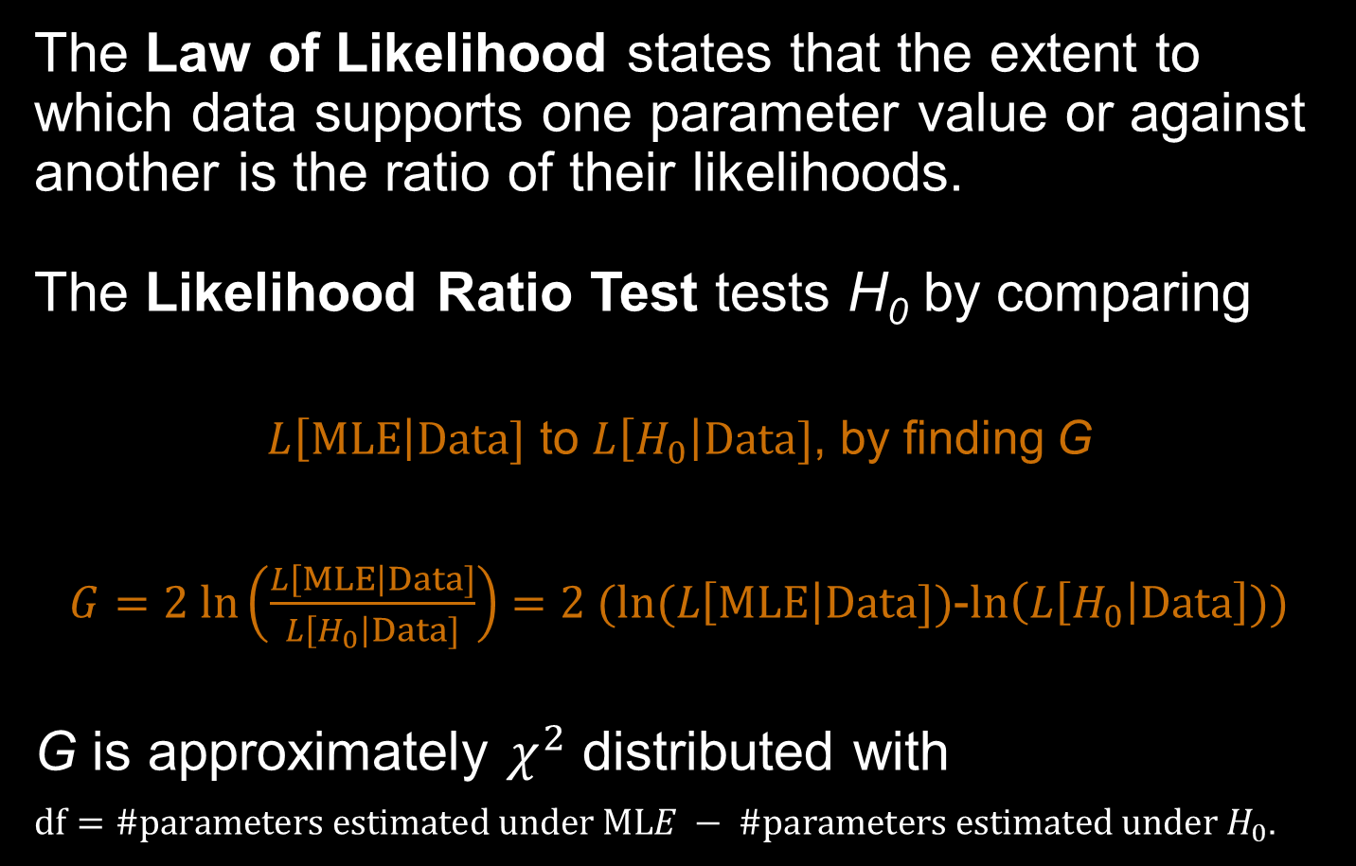
Log-likelihood ratio test
The Law of Likelihood states that the extent to which data supports one parameter value or against another is the ratio of their likelihoods.
The Likelihood Ratio Test tests H₀ by comparing
$L\left[MLE\right|Data]$ to $L\left[H_{0}\right|Data]$, by finding G
$G=2 ln\left(\frac{L\left[MLE\right|Data]}{L\left[H_{0}\right|Data]}\right)=$ $2 (ln(L\left[MLE\right|Data])$-$ln\left(L\left[H_{0}\right|Data\right]))$
G is approximately $χ^{2}$ distributed with
$df=\#parameters estimated under MLE − \#parameters estimated under H_{0}$.

Slide 40
Hypothesis testing using a Log-likelihood ratio test
H₀: Wasps choose mated and unmated females with equal probability (p=0.5)
H_{A}: Wasps prefer one type of female over the other (p≠0.5)

Slide 41

Hypothesis testing using a Log-likelihood ratio test
H₀: Wasps choose mated and unmated females with equal probability (p=0.5)
H_{A}: Wasps prefer one type of female over the other (p≠0.5)
$G=2ln⁡(\frac{L[\hat{p}|Y chose matedfemale]}{L[p_{0}|Y chose mated female]}$)
$$G=2(\ln{L\left[\hat{p} | Y chose matedfemale\right]}−\ln{L[p_{0}|Y chose mated female])}$$

Slide 42

Hypothesis testing using a Log-likelihood ratio test
H₀: Wasps choose mated and unmated females with equal probability (p=0.5)
H_{A}: Wasps prefer one type of female over the other (p≠0.5)
$G=2ln⁡(\frac{L[\hat{p}|Y chose matedfemale]}{L[p_{0}|Y chose mated female]}$)
$$G=2(\ln{L\left[\hat{p} | Y chose matedfemale\right]}−\ln{L[p_{0}|Y chose mated female])}$$
$$L{[0.72|23]}=\left(\frac{32}{23}\right){0.72}^{23}{(1−0.72)}^{32−23}$$
= -1.863

Slide 43

Hypothesis testing using a Log-likelihood ratio test
H₀: Wasps choose mated and unmated females with equal probability (p=0.5)
H_{A}: Wasps prefer one type of female over the other (p≠0.5)
$G=2ln⁡(\frac{L[\hat{p}|Y chose matedfemale]}{L[p_{0}|Y chose mated female]}$)
$$G=2(\ln{L\left[\hat{p} | Y chose matedfemale\right]}−\ln{L[p_{0}|Y chose mated female])}$$
$$L{[0.72|23]}=\left(\frac{32}{23}\right){0.72}^{23}{(1−0.72)}^{32−23}$$
= -1.863
$$L{[0.5|23]}=\left(\frac{32}{23}\right){0.5}^{23}{(1−0.5)}^{32−23}$$
= -5.031

Slide 44

Hypothesis testing using a Log-likelihood ratio test
H₀: Wasps choose mated and unmated females with equal probability (p=0.5)
H_{A}: Wasps prefer one type of female over the other (p≠0.5)
$G=2ln⁡(\frac{L[\hat{p}|Y chose matedfemale]}{L[p_{0}|Y chose mated female]}$)
$$G=2(\ln{L\left[\hat{p} | Y chose matedfemale\right]}−\ln{L[p_{0}|Y chose mated female])}$$
$$L{[0.72|23]}=\left(\frac{32}{23}\right){0.72}^{23}{(1−0.72)}^{32−23}$$
= -1.863
$$L{[0.5|23]}=\left(\frac{32}{23}\right){0.5}^{23}{(1−0.5)}^{32−23}$$
= -5.031
G = 2[-1.863-(-5.031) ]= 6.336
$χ_{0.05,1}^{2}=3.84$, p = 0.012

Slide 45
Summary
Likelihood quantifies how much the data supports a particular parameter value.

Slide 46
Summary
Likelihood quantifies how much the data supports a particular parameter value.
The maximum likelihood estimate is the parameter value for which the observed data are most probable.

Slide 47
Summary
Likelihood quantifies how much the data supports a particular parameter value.
The maximum likelihood estimate is the parameter value for which the observed data are most probable.
The likelihood-based 95% CI includes parameter values within 1.92 log-likelihood units of the MLE.

Slide 48
Summary
Likelihood quantifies how much the data supports a particular parameter value.
The maximum likelihood estimate is the parameter value for which the observed data are most probable.
The likelihood-based 95% CI includes parameter values within 1.92 log-likelihood units of the MLE.
Likelihood ratios can be used for hypothesis testing

Slide 49
Summary
Likelihood quantifies how much the data supports a particular parameter value.
The maximum likelihood estimate is the parameter value for which the observed data are most probable.
The likelihood-based 95% CI includes parameter values within 1.92 log-likelihood units of the MLE.
Likelihood ratios can be used for hypothesis testing
Likelihood-based inference is versatile and is the basis for many advanced statistical methods.

